Slide 1
Default of credit card clients
Group members:
Alexandra AMIENS
Julieva COHEN-SORS
Jing Fei XU
Michael WARNER
Suet Wah CHU

Slide 2
CONTENT
01
Introduction
Problem Statement
Data Source
02
Method
EDA
Data Modelling
03
Results
Model Validation
04
Conclusion

Slide 3
INTRODUCTION
Problem Statement Data Source
Original dataset: UCI Machine Learning Repository
Dataset consists of:
25 features
14 Numeric variables
9 Categorical variables
1 Target variable: Default (Yes = 1, No = 0)
ID column
3000 client records
Default Credit Card
Delinquent on credit card payments
Risk Management
Minimize losses
Main Goal
Predict the probability of default

Slide 4
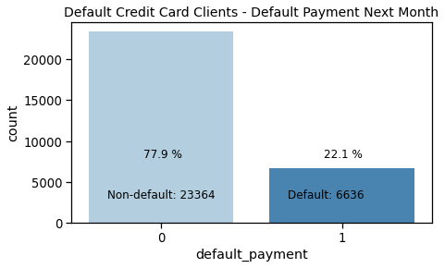
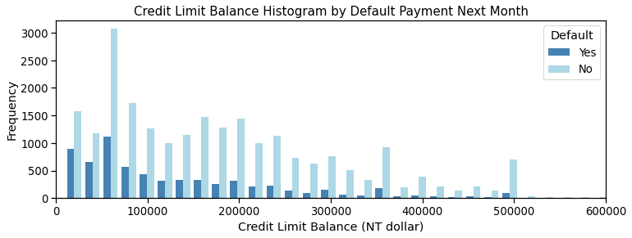
METHOD
EDA
Unbalanced data
Target Variable
Credit Limit:
Usually < 200,000 TWD
The lower the credit limit, the higher the chance of default payment
Numeric Variable

Slide 5
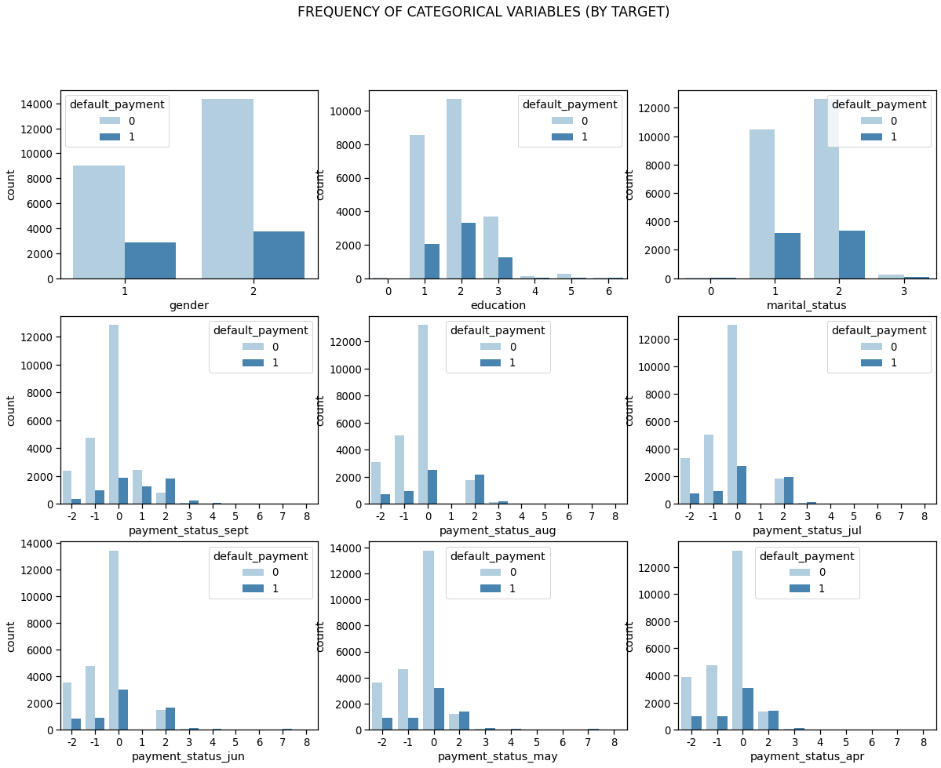
METHOD
EDA
Clients who have a higher default payment rate:
Male
High school level education
Married
Have payment delay for 2 months
Categorical Variable
One-Hot Encoding:
Convert categorical data to a numerical form

Slide 6
METHOD
Data Cleaning
Wrong Target Variable:
317 customers have no consumption at all but some of them have payment status 1 (1 month late payment) in September and default payment next month
Reassign Default Payment Next Month (Target variable):
1 -> 0 (not default)
Incorrect Target Variable
Reassign the payment status:
-2: No consumption;
-1: Paid in full;
0: The use of revolving credit;
all late payment move 1 month forward : (e.g. 2->1 ; 3->2 )
1 = payment delay for one month;
2 = payment delay for two months; . .
Wrong payment status :
The payment status jumps from 0 to 2 if the customer fails to repay a certain amount, that means they suddenly get late payment for 2 months but no late payment the previous month (i.e 0) instead of 1 month late payment before.
Incorrect Payment Status

Slide 7
METHOD
Data Modelling
Duplicate examples in the minority class
Random Oversampling
Delete examples in the majority class
Random Undersampling
3 ways for unbalanced classification problems
Synthetic Minority Oversampling Technique
SMOTE

Slide 8
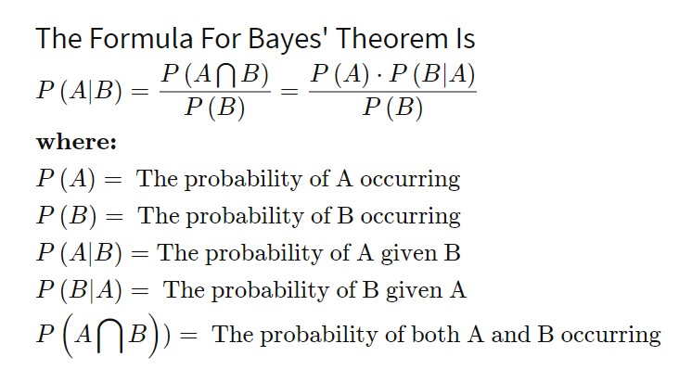
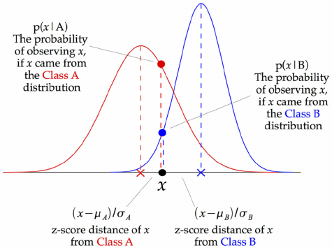
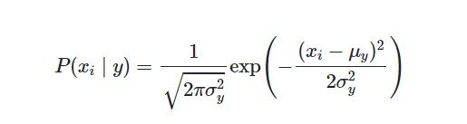
METHOD
Data Modelling
The best model:
Gaussian Naive Bayes
Based on Bayes Theorem
Predictive Models:
i) Logistic Regression
ii) Naive Bayes
iii) K-Nearest Neighbours
iv) Decision Tree
v) Random Forest
vi) AdaBoost Classifier
vii) Gradient Boosting Classifier
viii) XGBoost Classifier
Metric:
Recall of Class 1 (Default Payment)
Recall : TP/(TP+FN)
Formula
Notes:
Reference: https://iq.opengenus.org/gaussian-naive-bayes/
For evaluation, we choose recall as the metric as we would like to predict which customers are likely to have default payment next month based on prudence -- we rather overestimate the potential loss/short of income flow than underestimate it in the perspective of cash flow control and risk management. We want to identify as many default customers as possible even though some of them are not actually defaulted. Recall is the ratio of True Positive over the sum of True Positive and False Negative which is the probability that we predict correctly.

Slide 9
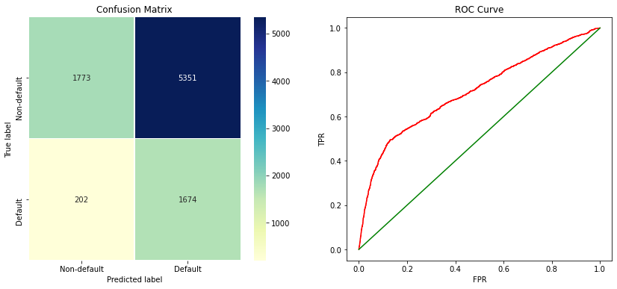
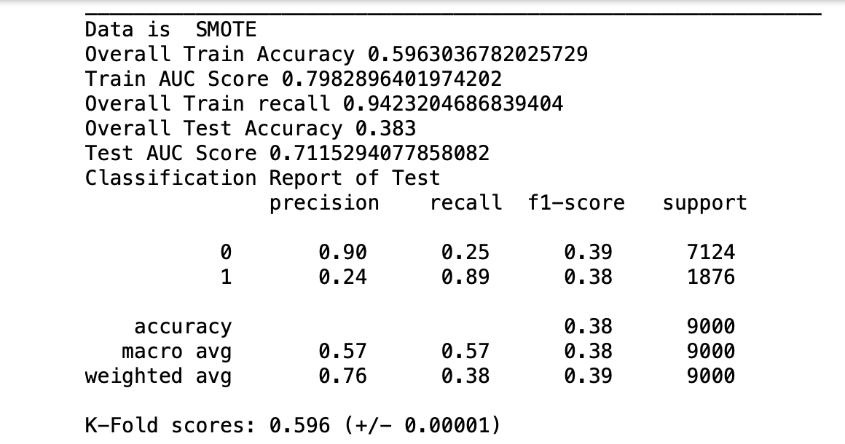
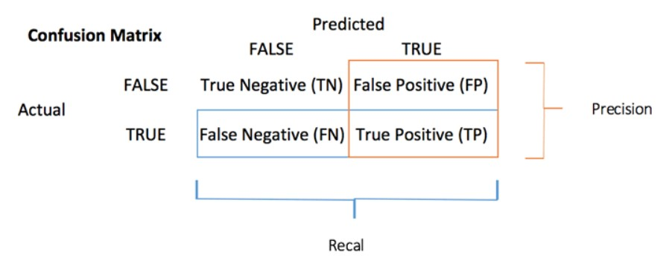
RESULTS
Model Validation
Confusion Matrix:
89% recall of class 1 (Default = Yes)
Aim to detect as many true defaulters as possible

Slide 10
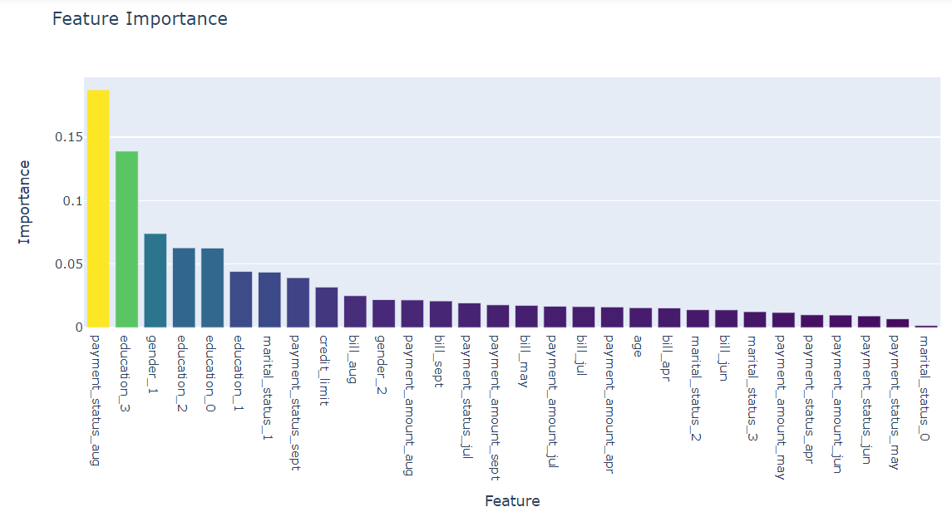
CONCLUSION
Based on the Decision Tree, the most important features are:
Payment Status in August
Education(High School)
Gender(Male)
Education(University)
Education(Others)
Marital Status(Married)
Payment Status in September
Credit Limit
Most of the important features are about the customers’ background and the most recent payment status

Slide 11
Thank You!

